Slide 1
Deep Learning Introduction
slides is based on stanford cs231n
NamHyuk Ahn

Slide 2
topics
Optimization and loss function
Backpropagation
------------------------------------------ <- basic prerequisites
Neural Network
Convolutional Neural Network
Case study of CNN

Slide 3
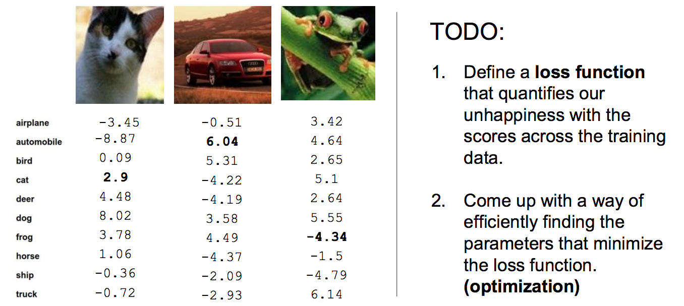
Loss function

Slide 4
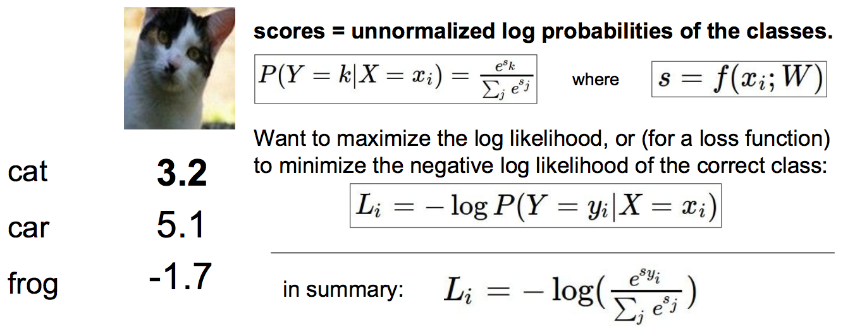
Softmax Classifier (Logistic Regression)

Slide 5
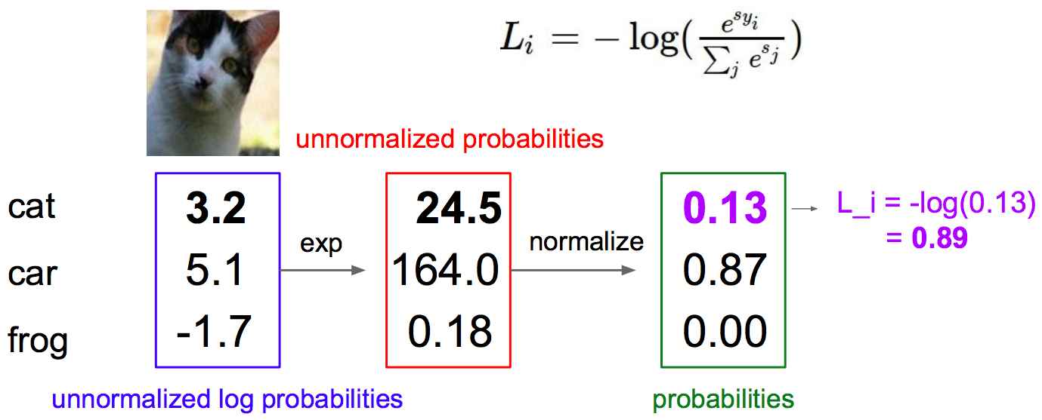
Softmax Classifier

Slide 6
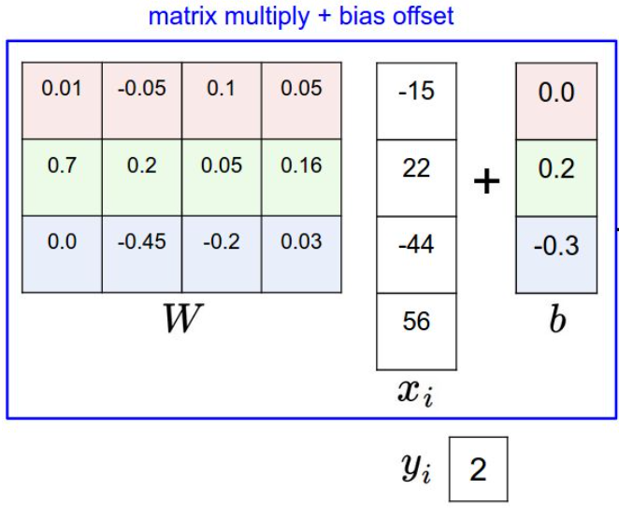
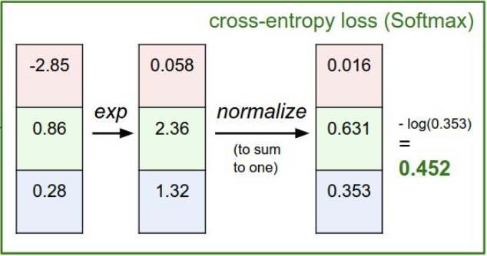

Slide 7
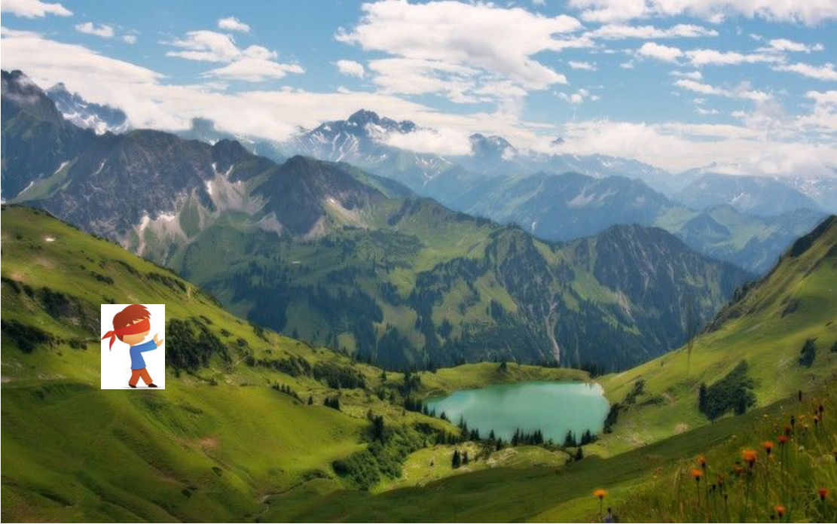
Optimization

Slide 8
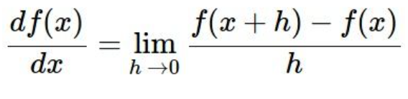
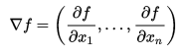
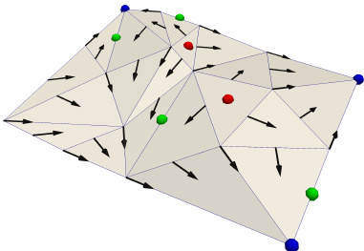
Optimization: Follow the slope
Using gradient!
Gradient means greatest rate of increase (or decrease) of the function

Slide 9
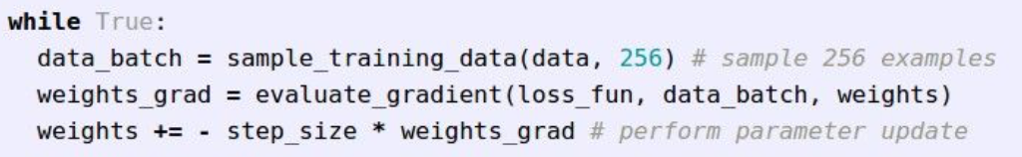
Gradient Descent
Full-batch GD
Mini-batch GD: only use small part of training set to compute gradient

Slide 10
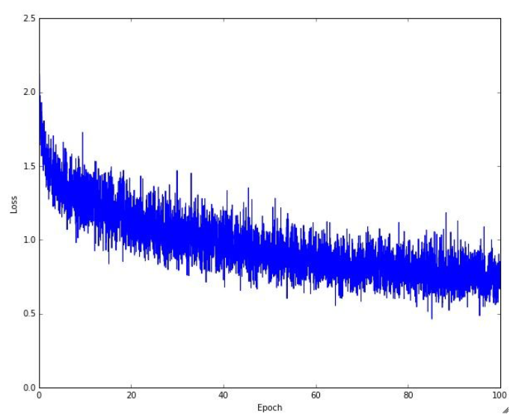
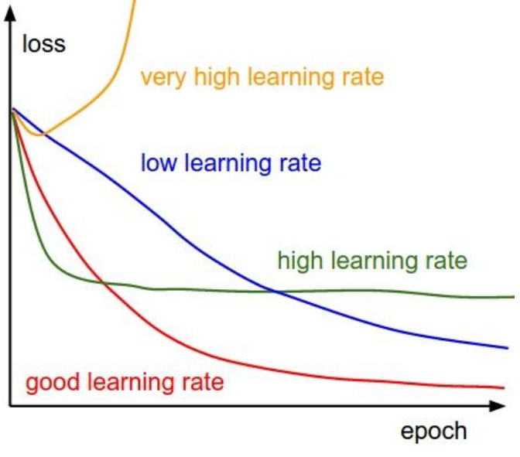

Slide 11
Learning rate is important
Before full training, you must found best learning rate (in machine learning it is called hyper-parameter tuning)
Just run few epoch(3~5?), and compare each learning rate
And narrow learning rate range, run again (5~10 epoch?)

Slide 12
epoch? iteration? batch size?
one epoch = one forward pass and one backward pass of all the training examples
batch size = the number of training examples in one forward/backward pass. The higher the batch size, the more memory space needed
number of iterations = number of passes, each pass using [batch size] number of examples.

Slide 13
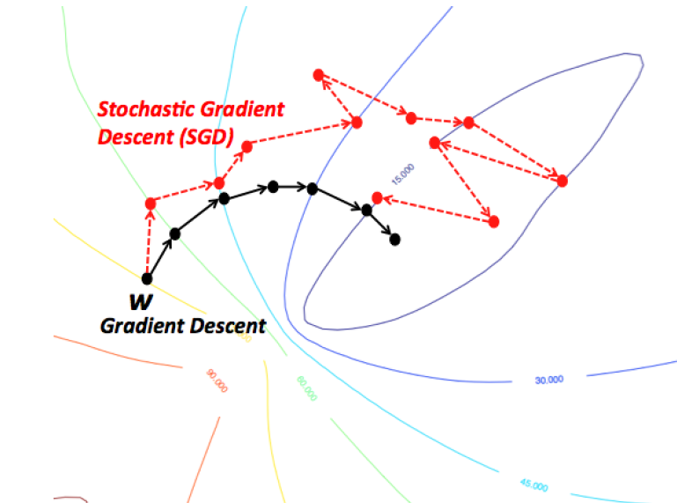
Why mini-batch?
Training set is huge, compute gradient of all dataset is impossible
If batch size is 1, we call Stochastic GD (but many people also say mini-batch as SGD)
In mini-batch, every examples of each batch is randomly selected

Slide 14


Another optimization algorithms...
Momentum
Nesterov Momentum
AdaGrad
RMSProp
Adam
....

Slide 15
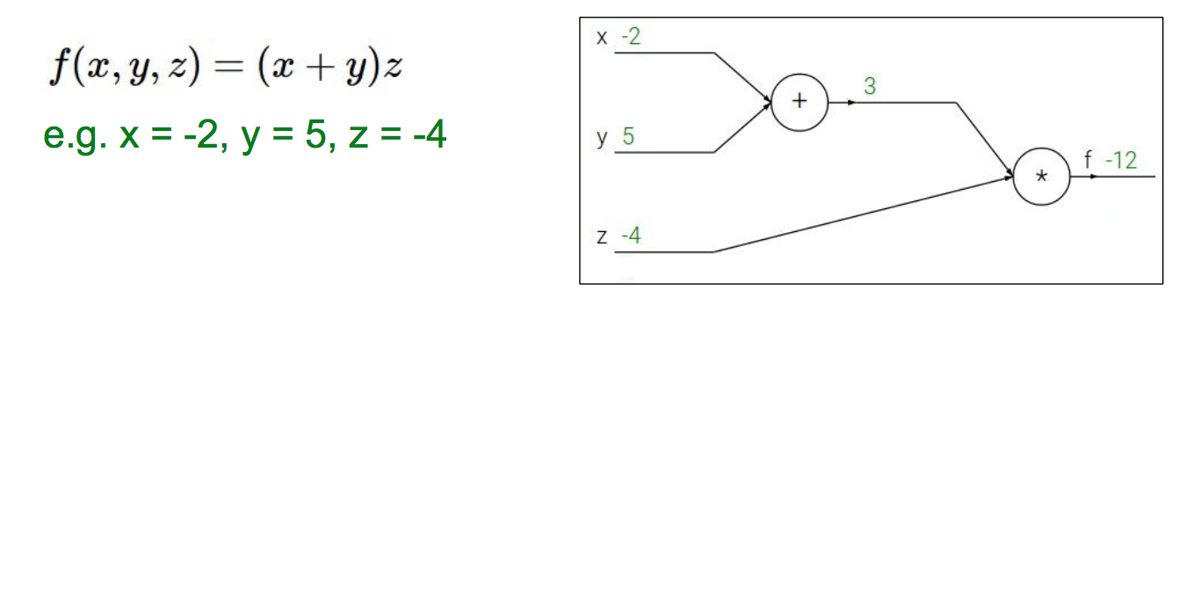
How to train neural network?
forward-propagation

Slide 16
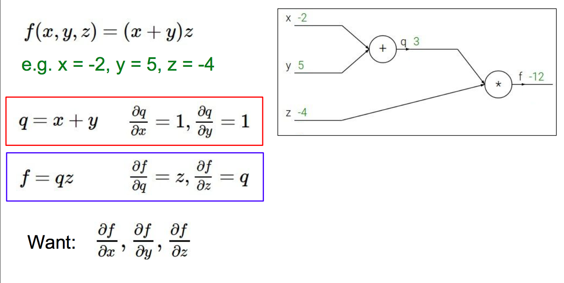
back-propagation

Slide 17
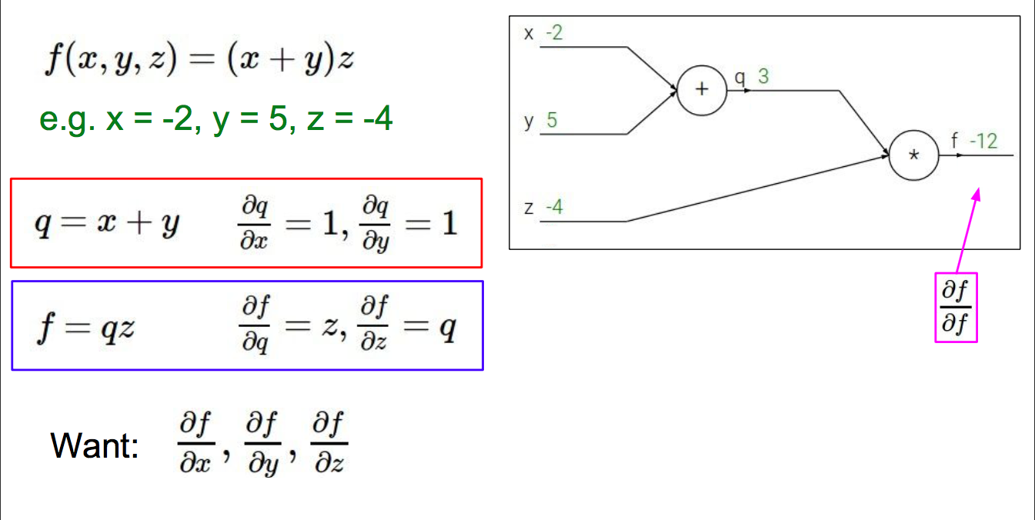

Slide 18


Slide 19
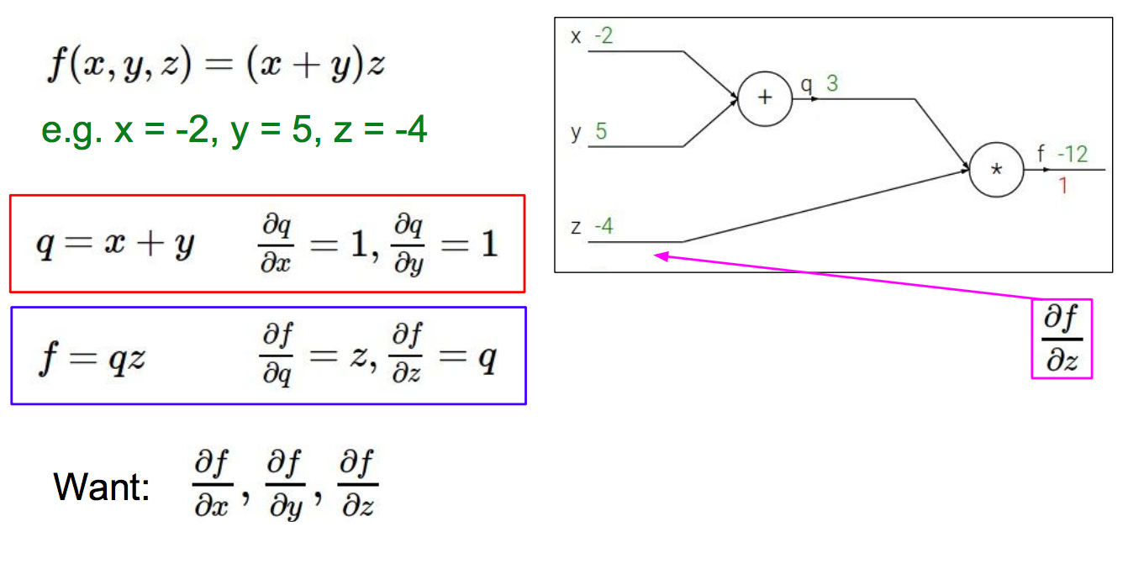

Slide 20
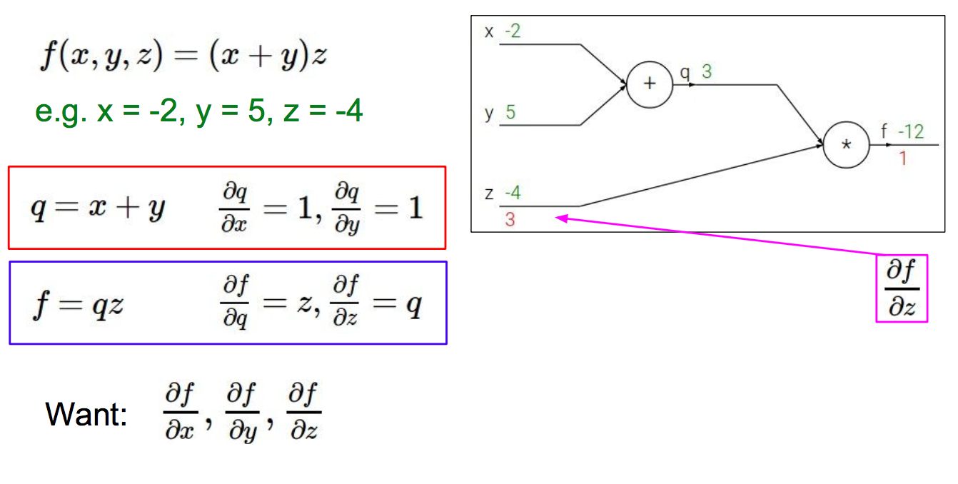

Slide 21
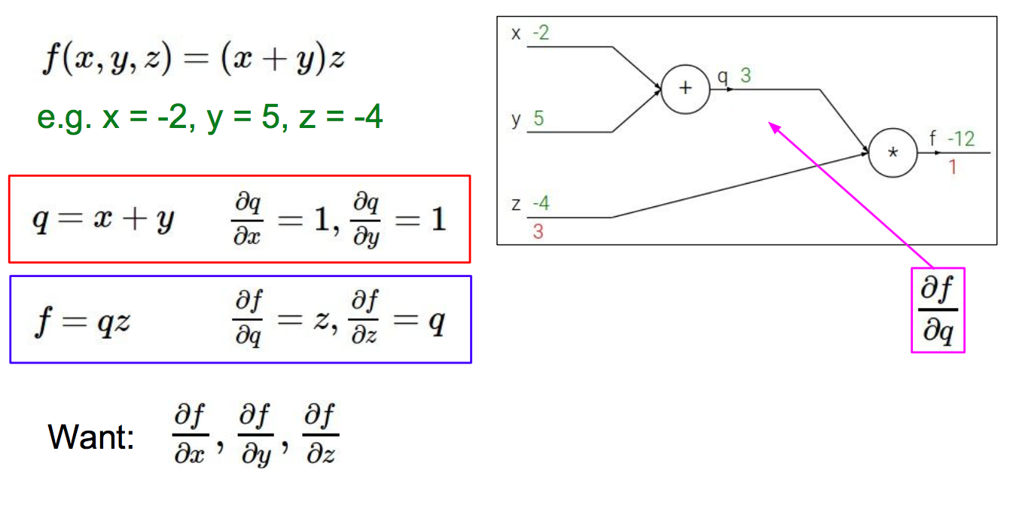

Slide 22
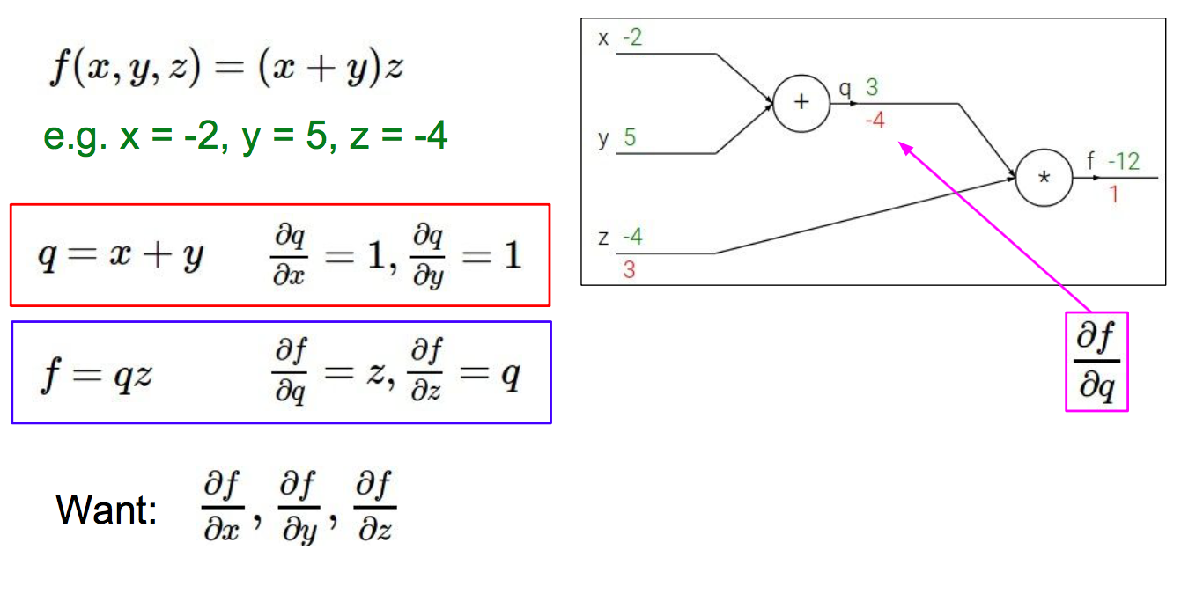

Slide 23
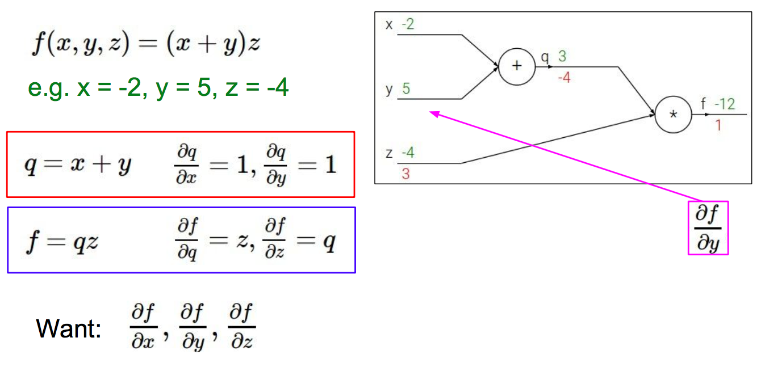

Slide 24
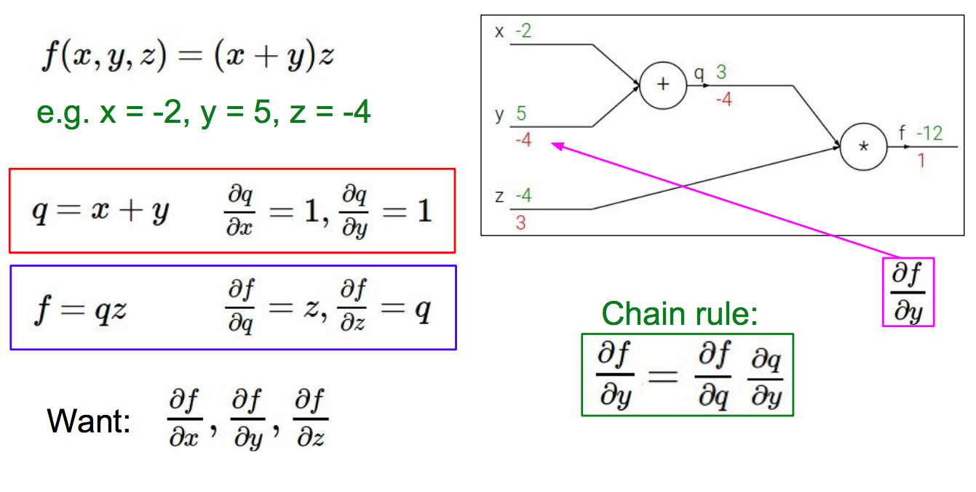

Slide 25
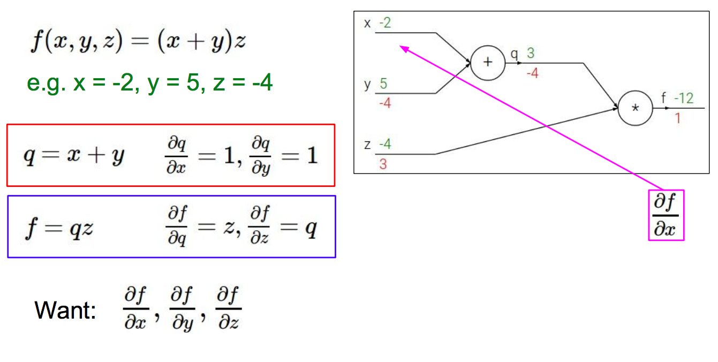

Slide 26
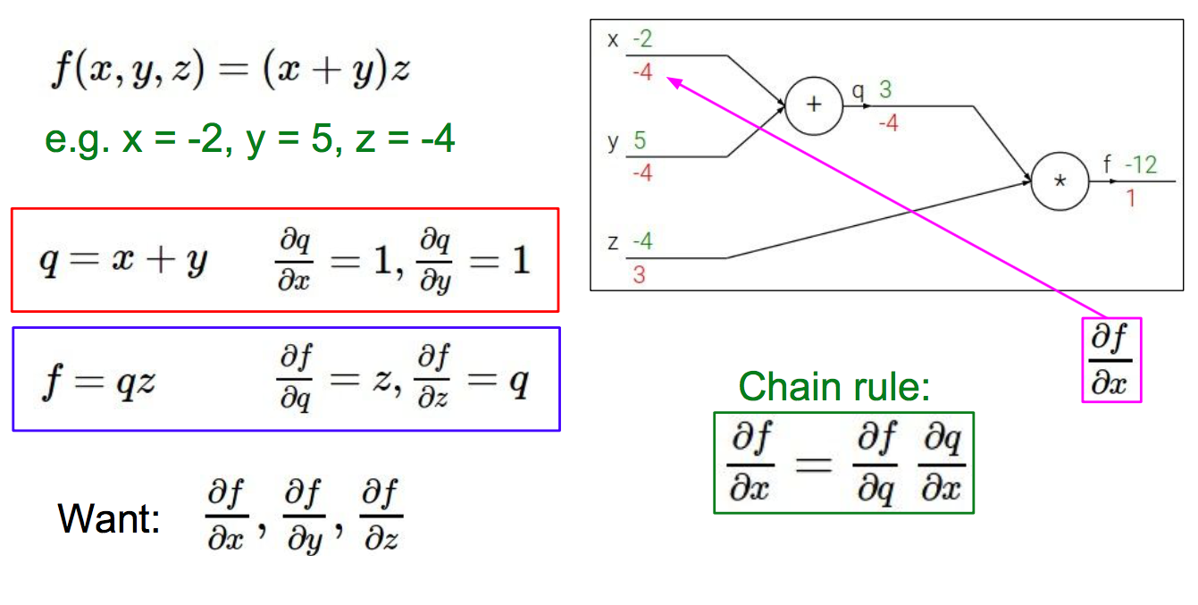

Slide 27
------------------------------------------ <- basic prerequisites

Slide 28
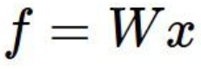
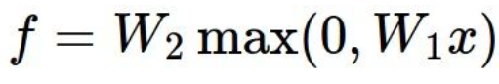
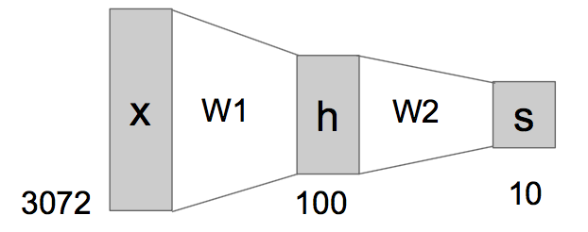
What is Neural Network?
Linear function
2-layer Neural Network
or more...

Slide 29
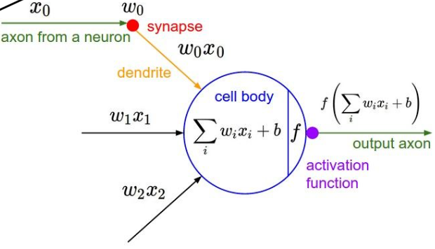
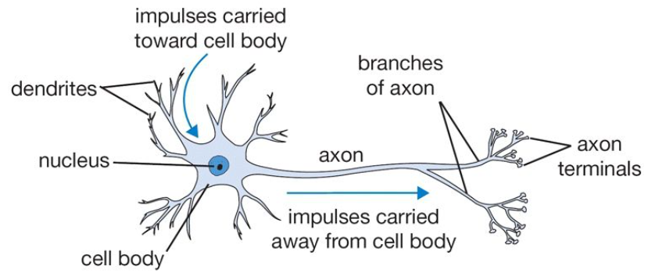
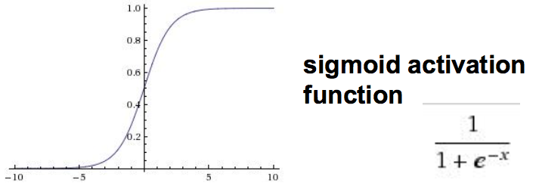

Slide 30
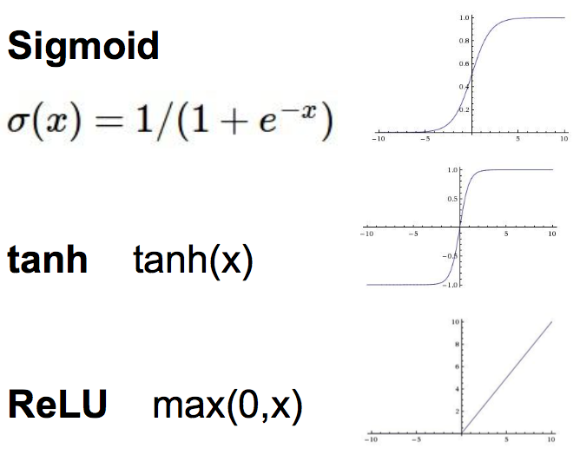
Activation functions
And more...

Slide 31
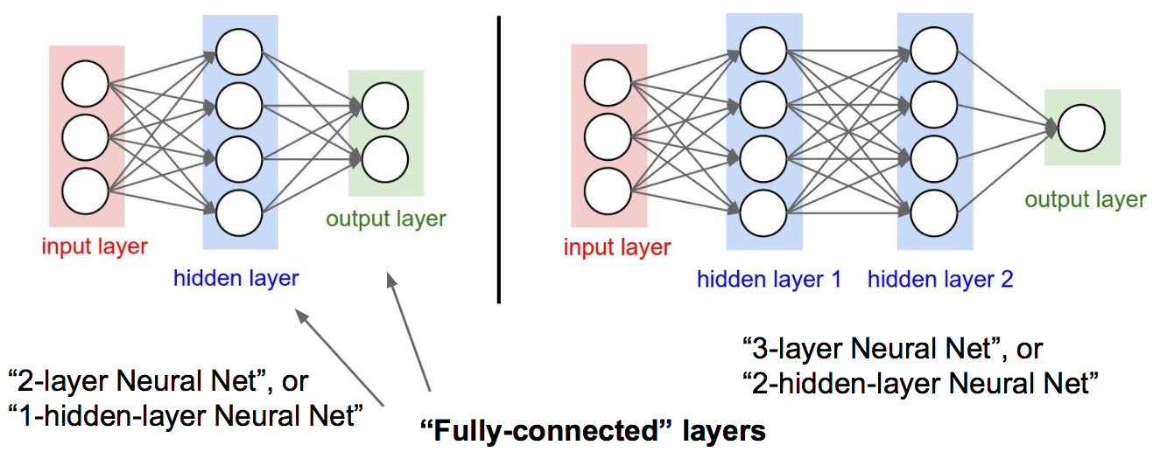
Neural Network: Architecture

Slide 32
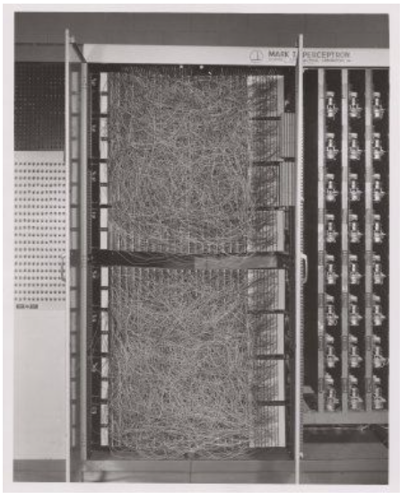
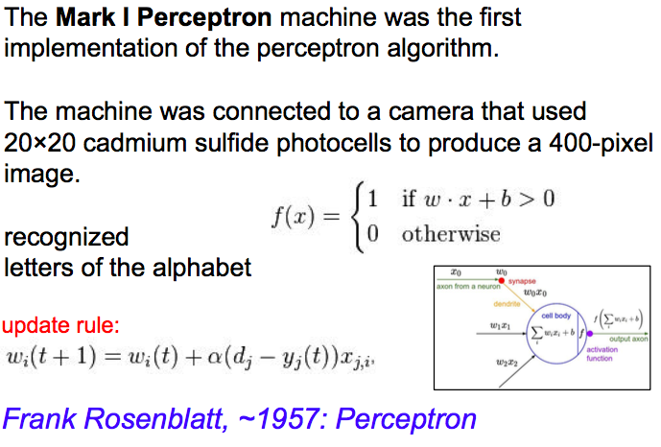
History of NN

Slide 33
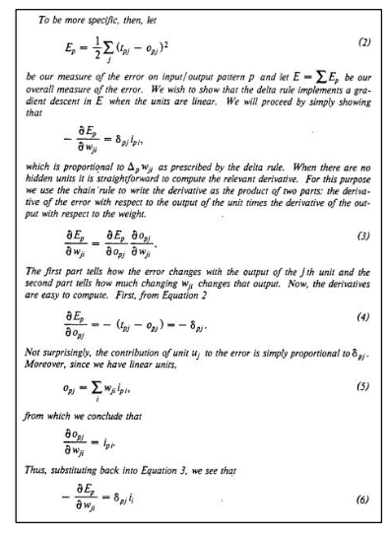
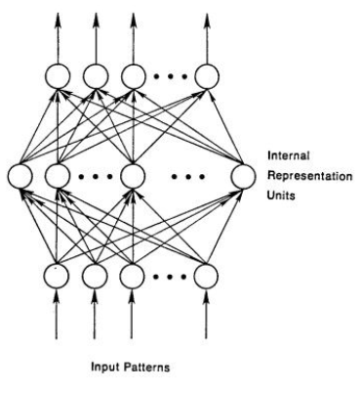
History of NN

Slide 34
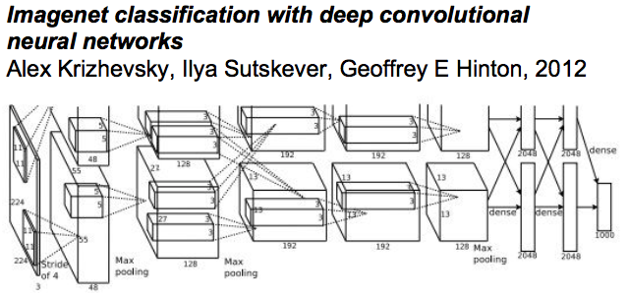
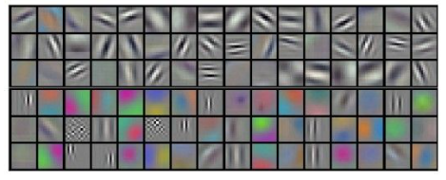
History of NN

Slide 35
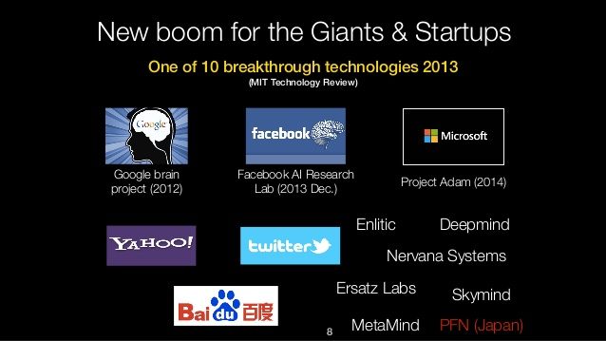
Deep learning everywhere

Slide 36
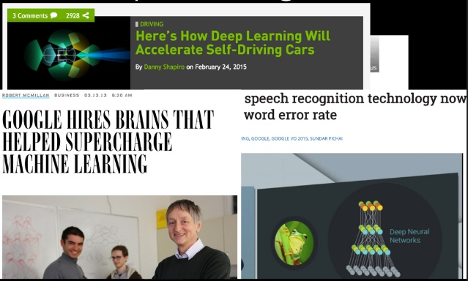
Deep learning everywhere

Slide 37
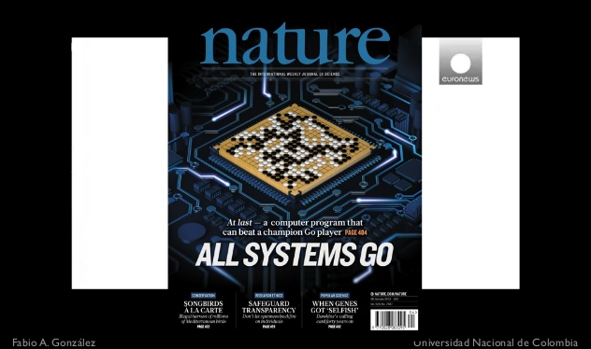
Deep learning everywhere

Slide 38
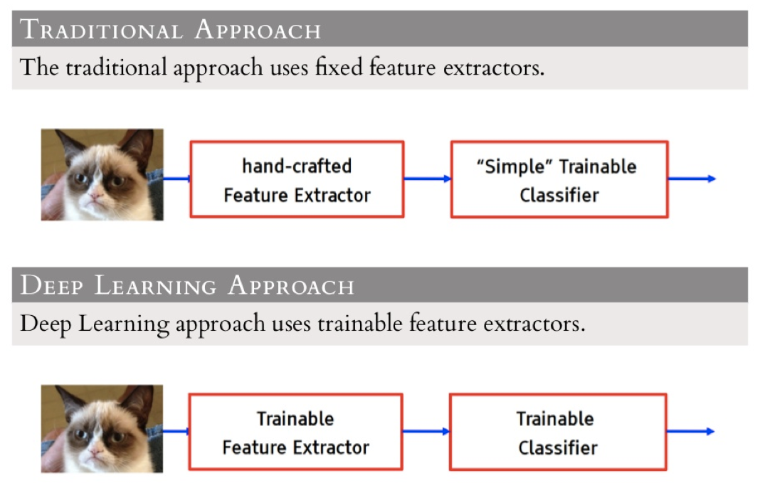
How deep learning works?
In computer vision area,

Slide 39
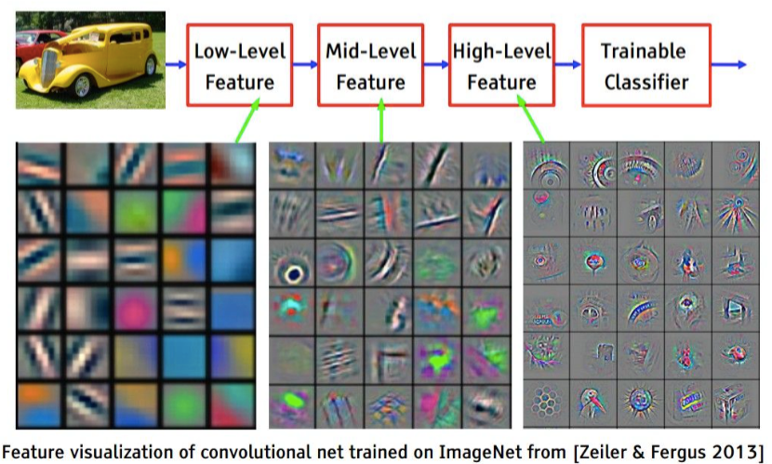

Slide 40

Convolutional Neural Network

Slide 41
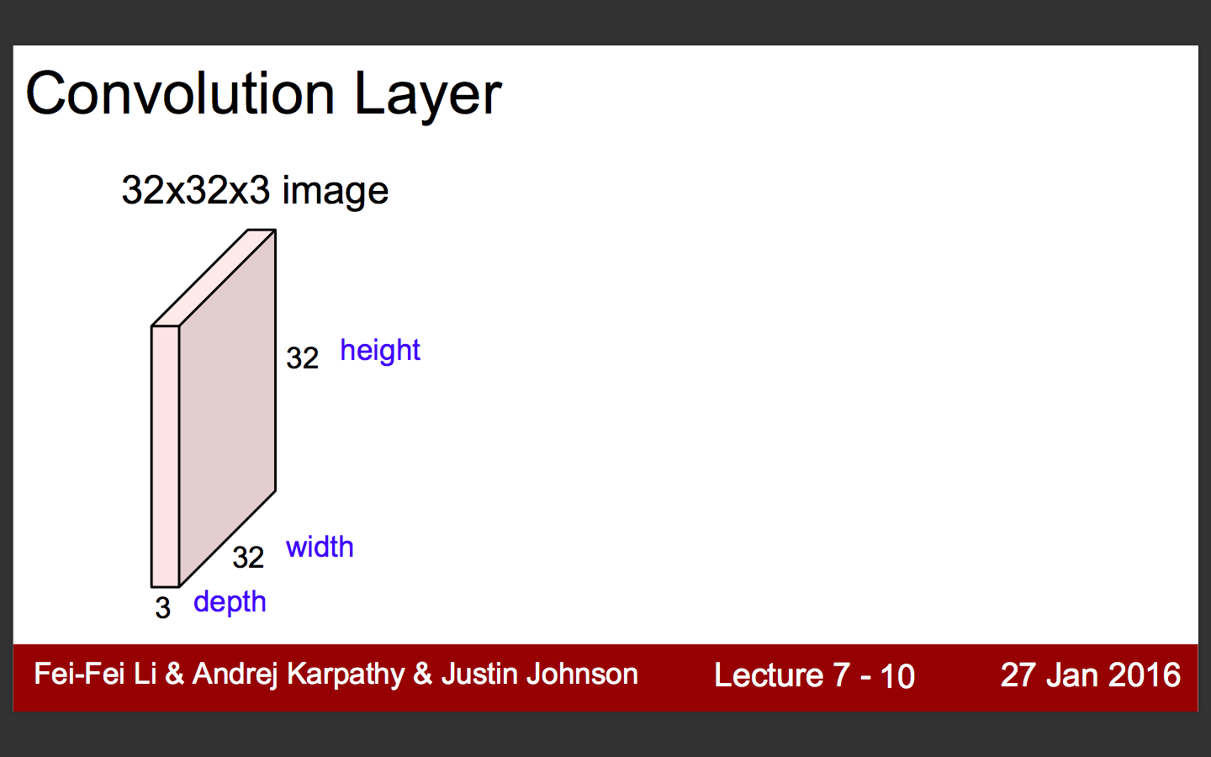

Slide 42
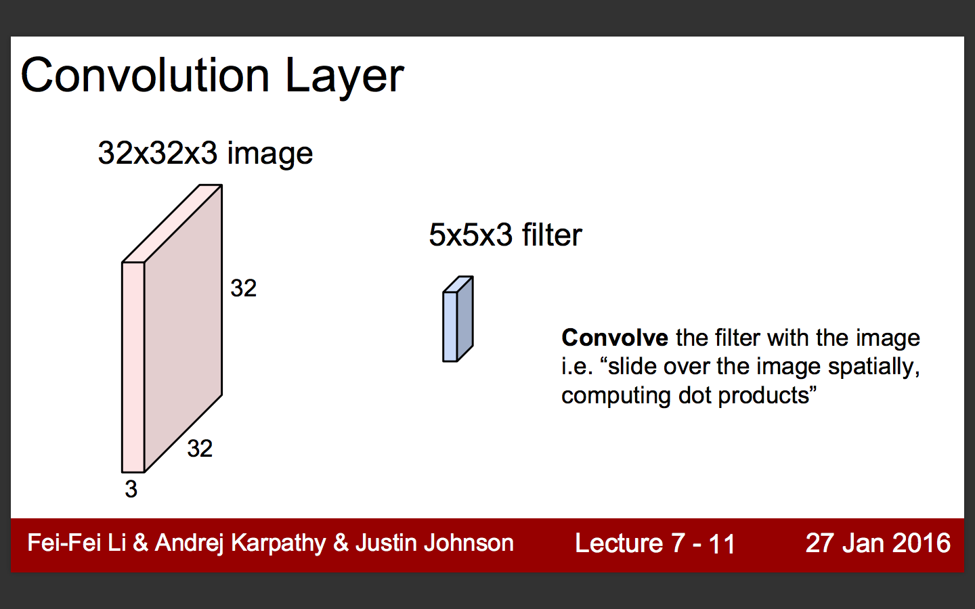

Slide 43
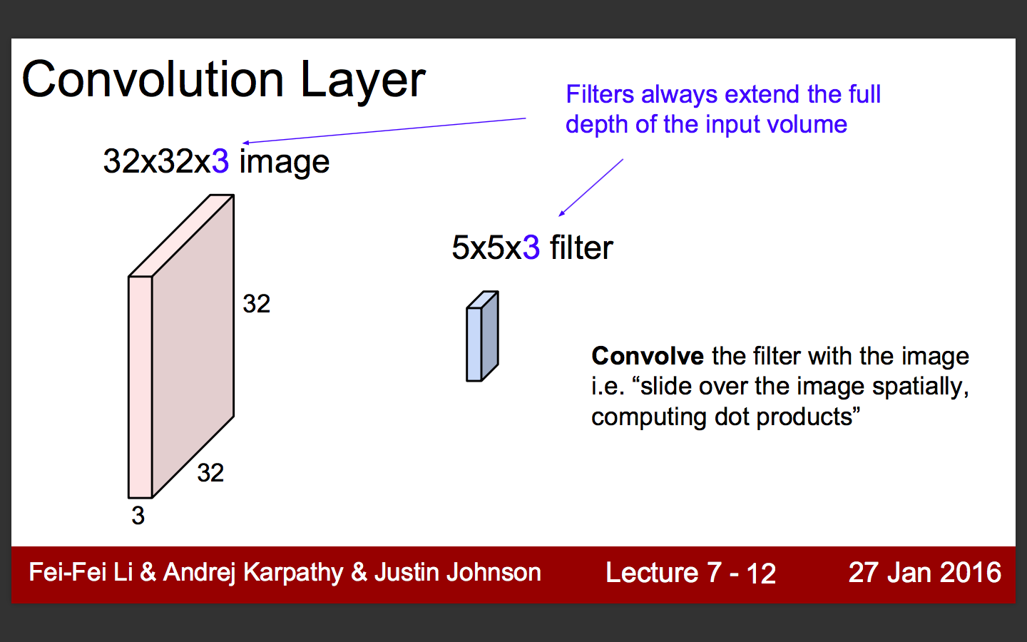

Slide 44
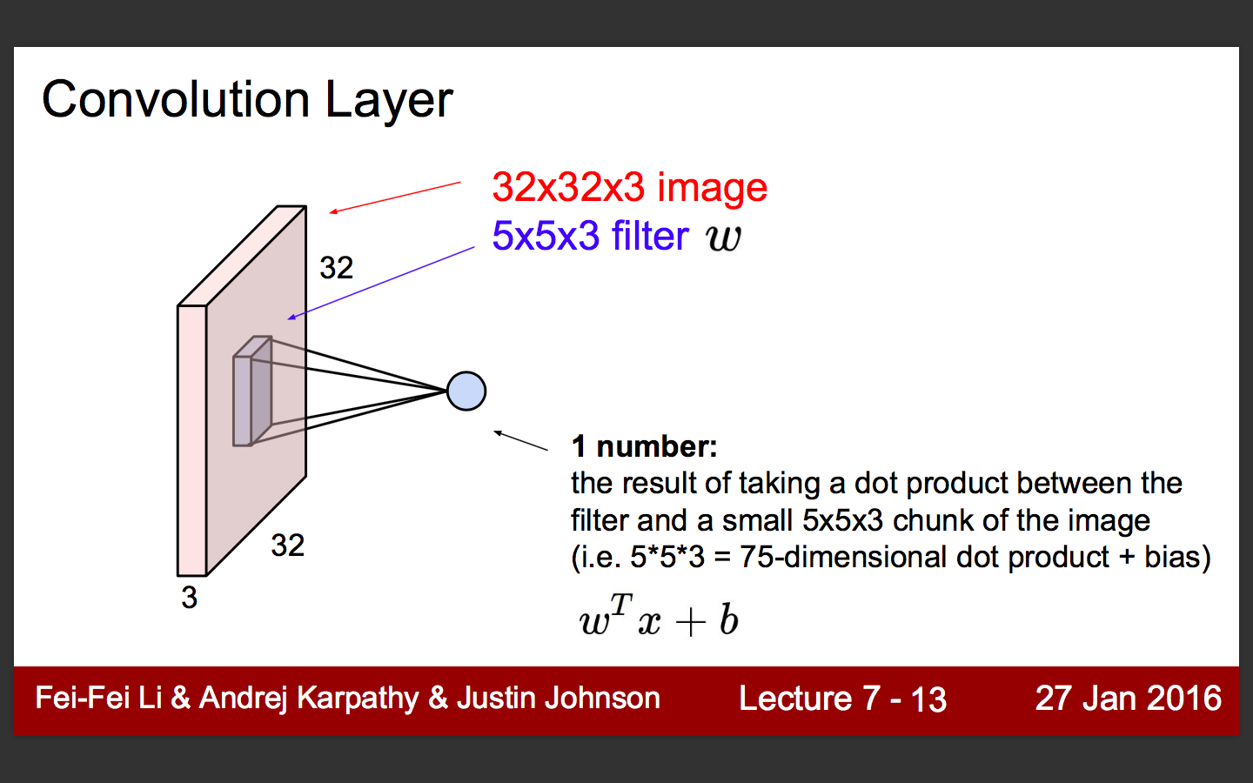

Slide 45
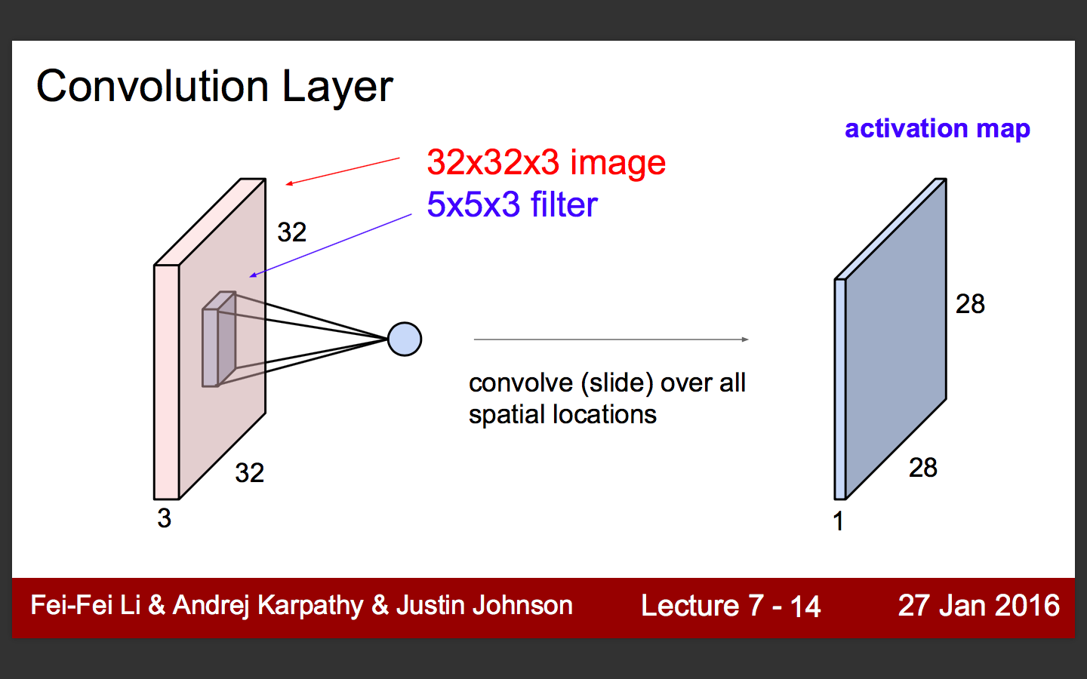

Slide 46
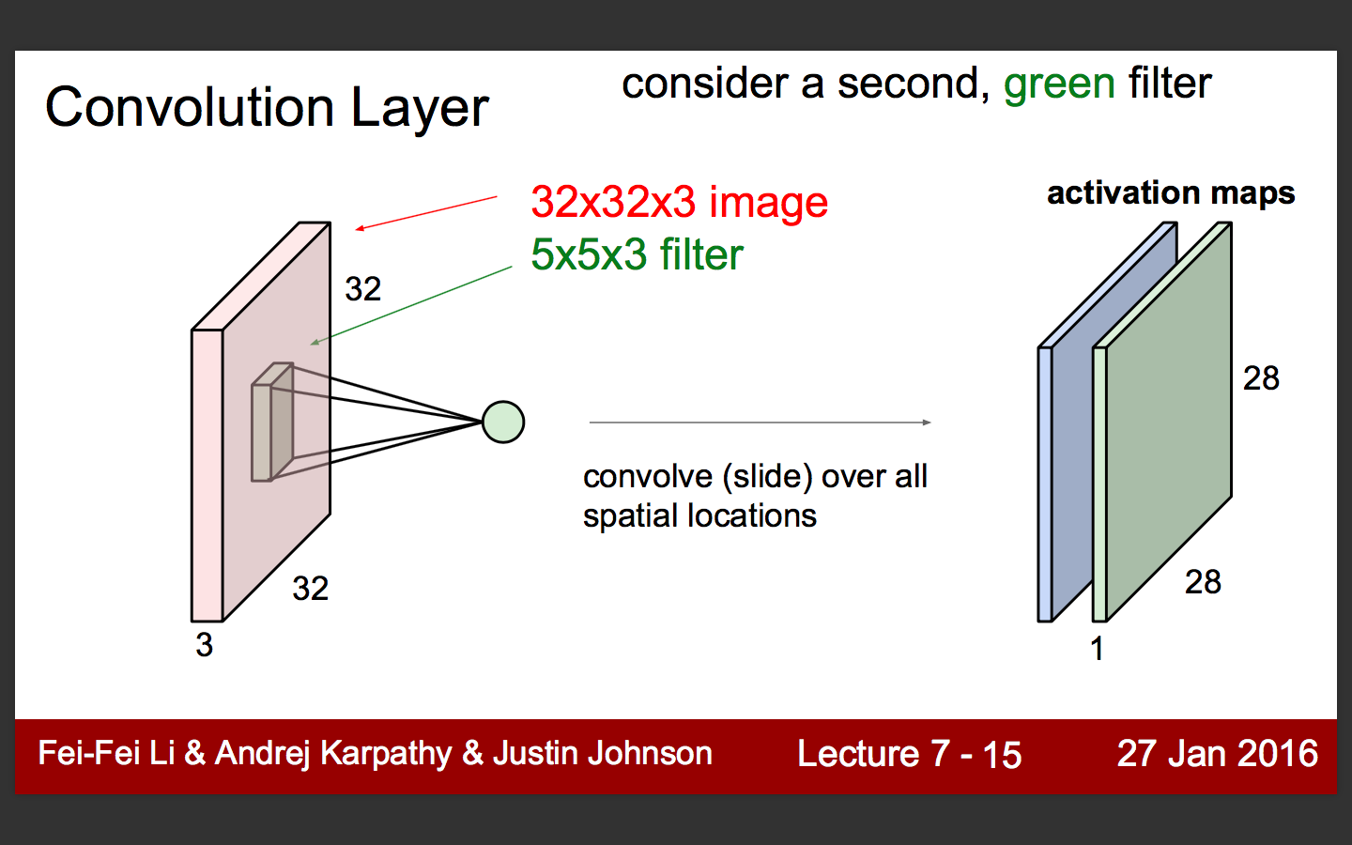

Slide 47
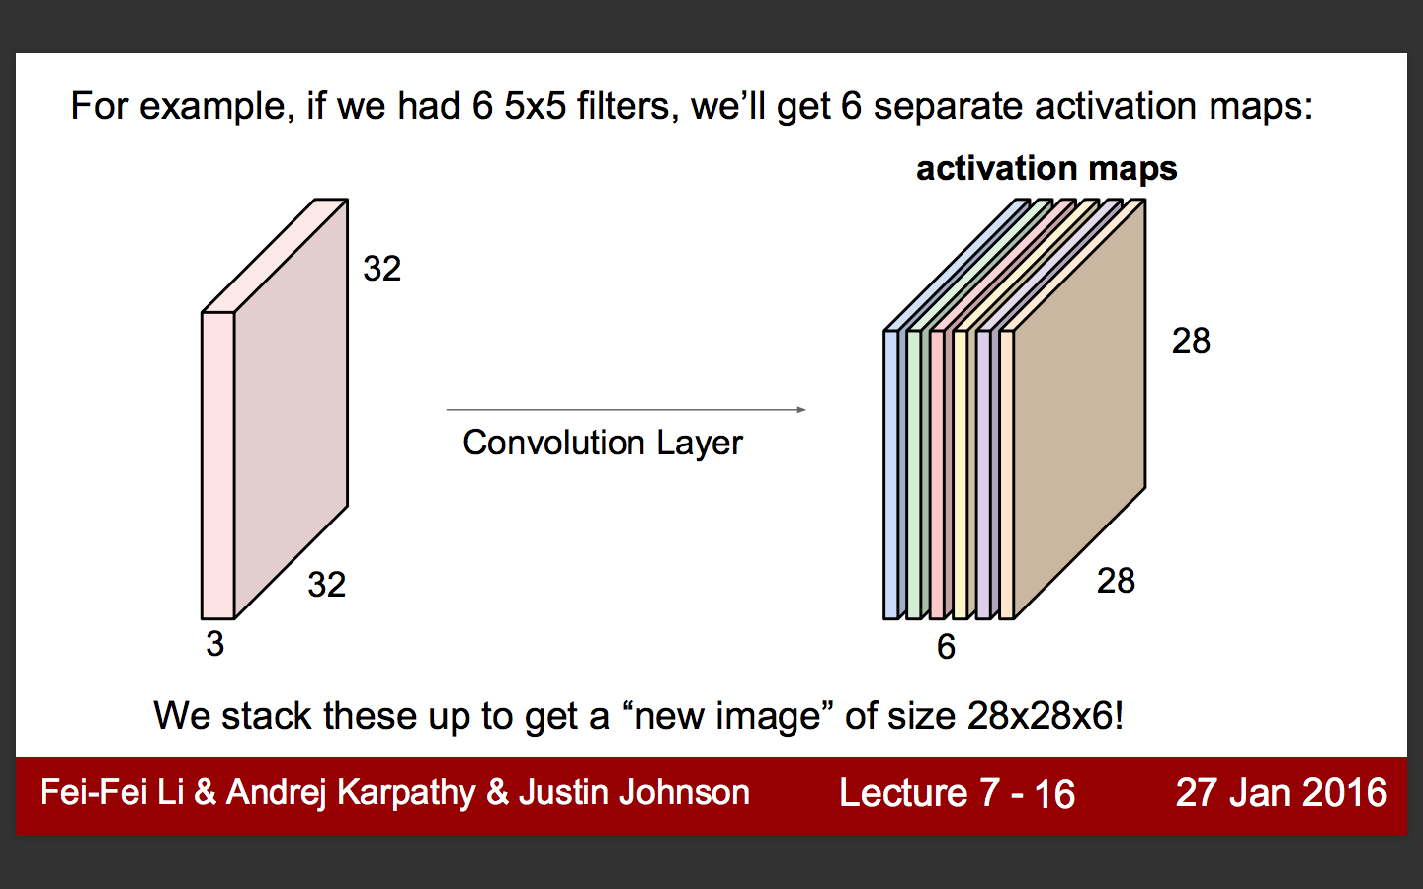

Slide 48
More about of Conv layer
Local Connectivity
Instead connect all pixels to neurons, connect only local region of input (called receptive field)
It can reduce many parameter
Parameter sharing
To reduce parameter, each channel have same filter. (# of filter == # of channel)

Slide 49

More about of Conv layer
EX) 1st conv layer in AlexNet
input: 224x224 filter: 11x11x3@96 output: 55x55
Each filter extract different features (i.e horizontal edge, vertical edge, color ...)

Slide 50


Activation function - sigmoid

Slide 51

Activation function - tanh

Slide 52

Activation function - ReLU

Slide 53

Pooling layer
Downsample image to reduce parameter
Usually use max pooling (take maximum value in region)

Slide 54

Usually, MAX POOL

Slide 55
Again..

Slide 56

How to train CNN?
Calculate loss function in forward path
Optimize parameter w.r.t loss function in backward path
Use SGD
...
Wait.. Do we have to implement this?
= Tensorflow save us!

Slide 57

Actually.. deep learning is not new

Slide 58
Why boooom again?
Computation power
Large database
Algorithm

Slide 59


Slide 60


Slide 61


Slide 62


Slide 63
Case study of CNN
AlexNet (2012)
VGGNet (2014)
GoogLeNet (2014)
ResNet (2015)

Slide 64
AlexNet (2012)
ReLU, Dropout
Data augmentation
SGD + momentum (mini-batch)
Weight Decay
LPN (Local Response Normalization)
Ensemble model (1-CNN: 18.2%, 7-CNN: 15.4%)

Slide 65

Dropout
Similar to bagging (approximation of bagging)
Act like regularizer (reduce overfit)
Instead of using all neurons, “dropout” some neurons randomly (usually 0.5 probability)

Slide 66

Dropout
At test time, not “dropout” neurons, but use weighted neurons (usually 0.5)
Weight is expected value of each neurons

Slide 67

Data augmentation
Imagenet Database has variety size of images
First, resize images into 256x256 size
Second, randomly crop 256x256 images to 224x224
At test time, crop 5 images and average to predict

Slide 68

And more..
Weights must be initalized randomly
If not, all gradients of neurons will be same
Usually, use gaussian distribution, std = 0.01
Use mini-batch SGD and momentum SGD to update weight

Slide 69
VGGNet (2014)
Use small size kernel (always 3x3)
AlexNet use 11x11, 5x5, 3x3 ...
Can use multiple non-linearlity (e.g. ReLU)
Less weights to train
Hard data augmentation (more than AlexNet)
Ensemble 7 model (ILSVRC submission: 7.3%)

Slide 70

And more..

Slide 71

Deeper means...
32-batch train => almost 6GB VRAM!
But imagenet database has 1M images...
Train 2~3 weeks using TITAN X x2 (TITAN X is almost (more?) $1000)

Slide 72

Summary so far,

Slide 73

GoogLeNet (2014)

Slide 74


Inception module
Use 1x1, 3x3 and 5x5 conv simultaneously to capture variety of structure
Capture dense structure to 1 more spread out structure to 3x3, 5x5
Computational expensive
Use 1x1 conv layer to reduce dimension (will explain details in later in ResNet)

Slide 75

Auxiliary Classifiers
We sure gradient flows effectively?
Limitation of deep network
So,
Loss of auxiliary is added to total loss (weighted by 0.3), remove at test time

Slide 76

Average pooling
Proposed in Network in Network (also used in GoogLeNet)
Problems of fc layer
Needs lots of parameter, easy to overfit
Replace fc to average pooling

Slide 77

Average pooling
Make channel as same as # of class in last conv
Calculate average on each channel, and pass to softmax
Reduce overfit!

Slide 78
before ResNet
Have to know about
Xavier Initialization (He Initialization)
Batch Normalization

Slide 79
Xavier Initialization
If initialize with gaussian distribution, output of neurons will be nearly zeros when network is deeep
If increase std (1.0), output will saturate to -1 or 1
Xavier initialization decide initial value by number of input neurons
Looks fine, but this init method assume linear activation so not good for ReLU

Slide 80


Output is saturated
Output is vanished

Slide 81


He Initialization
Xavier Initalization
He Initialization

Slide 82
Batch Normalization
Make output to be gaussian distribution, but normalization cost a lot
Calculate mean, variance in each dimension (assume each dims are uncorrelated)
Calculate mean, variance in mini-batch (not entire set)
Normalize constrain non-linearlity and constrain network by assume each dims are uncorrelated
Linear transform output (factors are parameter)

Slide 83

Batch Normalization
When test, calculate mean, variance using entire set (use moving average)
BN act like regularizer (don’t need Dropout <- really?)

Slide 84
ResNet (2015)

Slide 85


Slide 86


Slide 87


Slide 88


Slide 89


Slide 90


Slide 91


Slide 92


Slide 93


Slide 94


Slide 95


Slide 96

Deep Bottleneck
To reduce training time, modify as bottleneck design
(3x3x3)x64x64 + (3x3x3)x64x64=221184 (left)
(1x1x3)x256x64 + (3x3x3)x64x64 + (1x1x3)x64x256=208896 (right)
More width(channel) in right, but similar parameter
Similar method also used in GoogLeNet

Slide 97
More about ResNet
Regular data augmentation
Batch Normalization (no dropout)
He initialization
Average pooling instead of FC layer
VGGNet style overall structure

Slide 99
So,
Dropout, BN
ReLU-like activation
He initalization
Average pooling
Use pre-trained model :)

Slide 100

Pre-trained network
https://github.com/tensorflow/models/tree/master/slim

Slide 101

But when you use neural network

Slide 102

Nice tutorial lecture
https://www.youtube.com/watch?v=L8Y2_Cq2X5s&list=PLmImxx8Char9Ig0ZHSyTqGsdhb9weEGam&index=7
After watch this lecture, we will provide practice examples (until this week)

Slide 103
TODO
Watch tensorflow lecture
Do practice exercise
Mini-project brainstorming
Will do next internship week

Slide 104
This is just basic of deep learning
If you want more,
Recommend stanford cs231n lecture
REAAAALLLLY famous, good for newbie
(also this slide is based on cs231n lecture slide....)
Read papers..
cs231n lecture also recommend some good papers

Slide 105
Reference
Krizhevsky, Alex, Ilya Sutskever, and Geoffrey E. Hinton. "Imagenet classification with deep convolutional neural networks." Advances in neural information processing systems. 2012.
Simonyan, Karen, and Andrew Zisserman. "Very deep convolutional networks for large-scale image recognition." arXiv preprint arXiv:1409.1556 (2014).
Lin, Min, Qiang Chen, and Shuicheng Yan. "Network in network." arXiv preprint arXiv:1312.4400 (2013).
He, Kaiming, et al. "Delving deep into rectifiers: Surpassing human-level performance on imagenet classification." Proceedings of the IEEE International Conference on Computer Vision. 2015.
He, Kaiming, et al. "Deep Residual Learning for Image Recognition." arXiv preprint arXiv:1512.03385 (2015).
Szegedy, Christian, Sergey Ioffe, and Vincent Vanhoucke. "Inception-v4, Inception-ResNet and the Impact of Residual Connections on Learning." arXiv preprint arXiv:1602.07261 (2016).
Gu, Jiuxiang, et al. "Recent Advances in Convolutional Neural Networks." arXiv preprint arXiv:1512.07108 (2015). (good for tutorial)
http://cs231n.stanford.edu/index.html

